Slide 1
Minor Project: Rash driving Analysis for Safety Enforcement (R.A.S.E.)
Urvi Bhanushali 5
Harsh Dave 10
Ayush Ghanekar 15

Slide 2
Aim
Rash and reckless driving is one of the major causes of hazardous road accidents and usually goes unnoticed by the agencies.
Rash driving usually follows a similar pattern across drivers and our aim is to identify this by the use of sensors present in the car and alert the user as well as related authorities (RTO, Police) before it leads to an accident.

Slide 3
Current Objectives
The system will read gyrometer and accelerometer data to analyze the changes in speed and check for sudden breaking.
It will also check for whether the driver is over speeding by checking it with speed limits.
Sudden acceleration and sudden deceleration will be noted and warnings or penalties can be given as suited

Slide 4
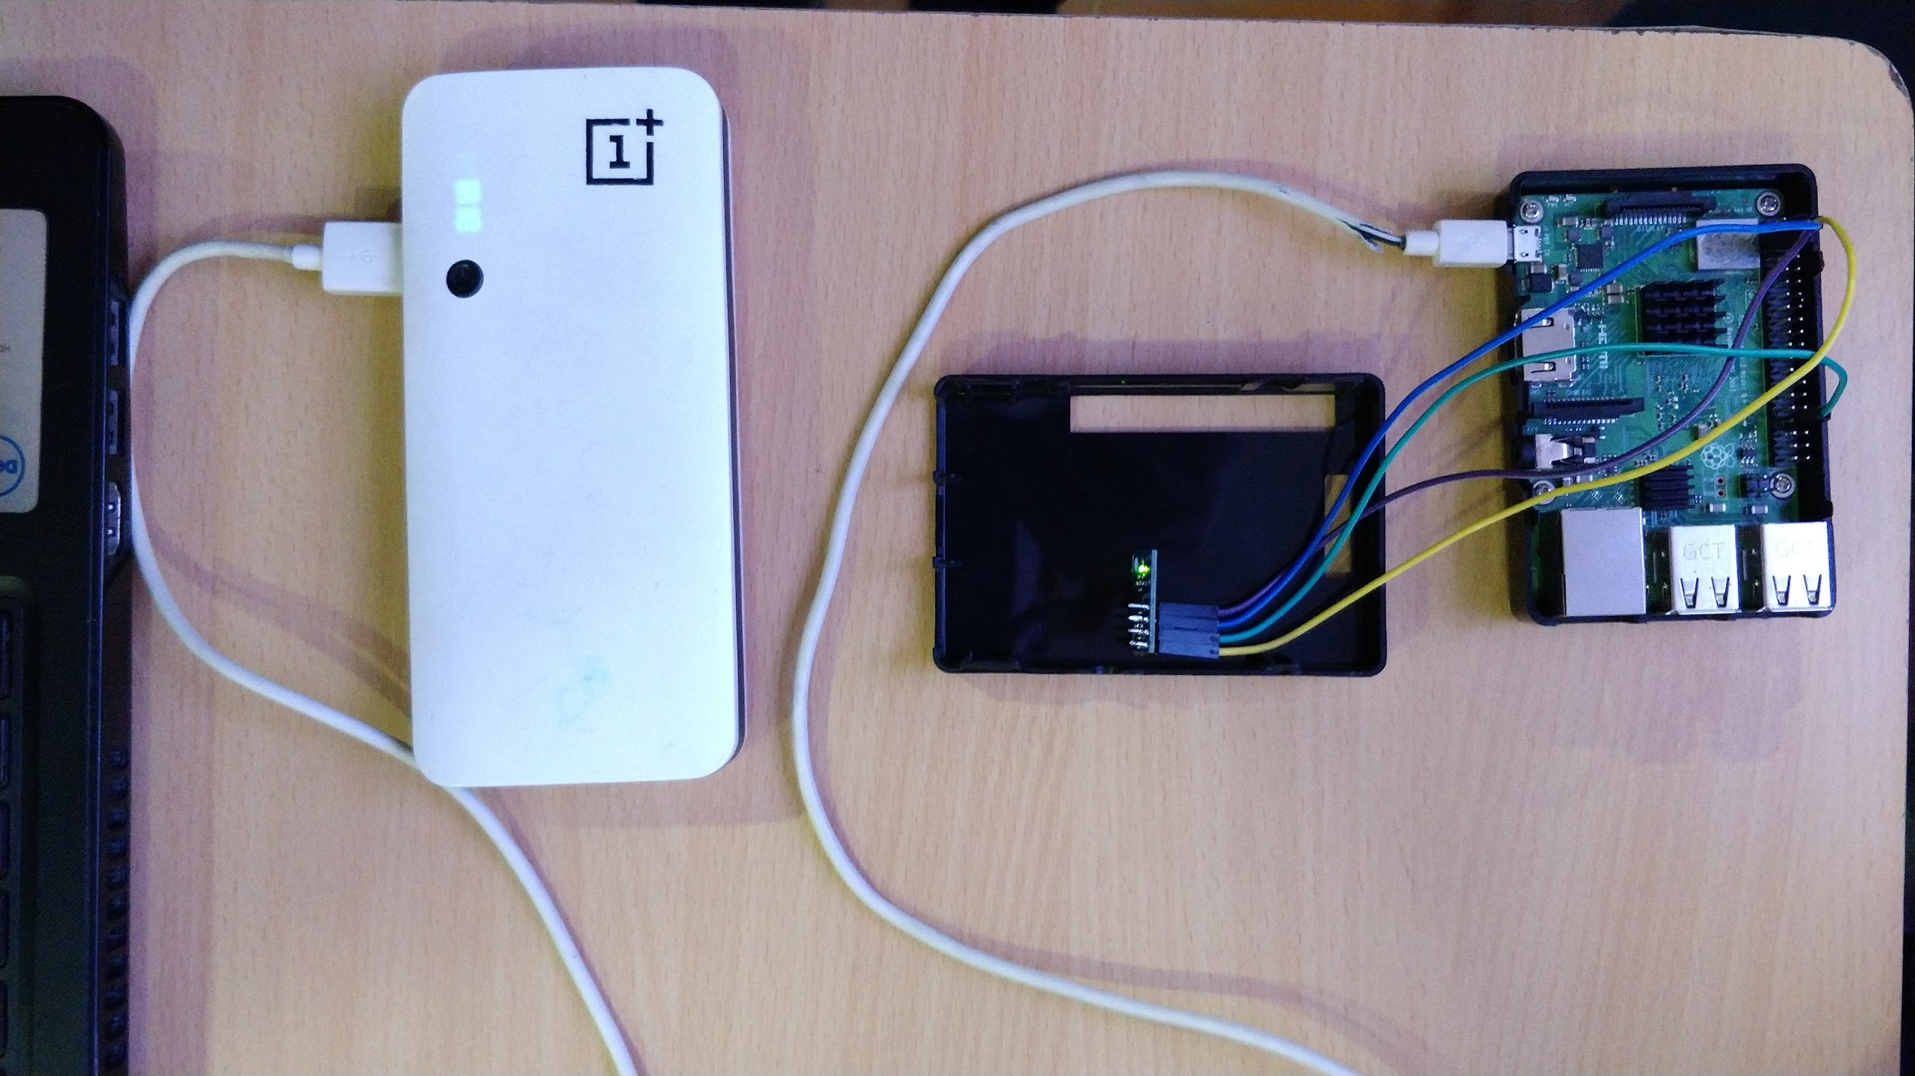
Hardware and technology used
Raspberry Pi Model 3 B+

Slide 5
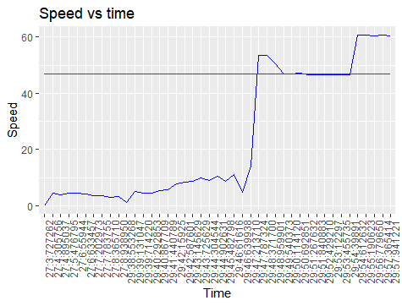
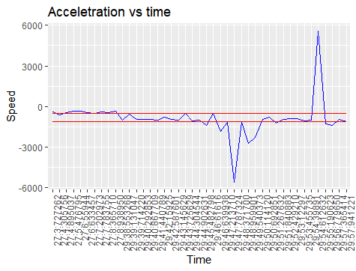
Analysis conducted
Speed-time graph
Acceleration-time graph

Slide 6
Future scope
To check for whether the driver is over speeding by accessing the geo-positional data of the vehicle to check for speed limit in particular area using Google API.
The radius of turn will be calculated using sensors.
This data will be compiled to form a point based system for each driver, where points are deducted for rash and negligent driving with penalties after every interval of point deduction.

